Slide 1
LEAD SCORE CASE STUDY
Case study partners
Priya Sharma
Priyanka Shamrao
Priyanka Mukherjee

Slide 2
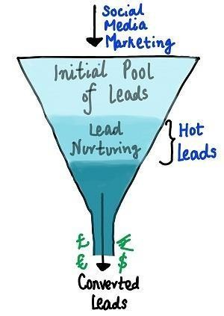
Problem statement
Problem Statement
X Education offers online courses for professionals. Many people visit their website to see the courses. They advertise on various websites and Google. Some visitors give their email or phone and become leads. They also get leads from referrals. The sales team contacts these leads and tries to make them customers. But only 30% of leads become customers. X Education wants to find the “hot leads” who are more likely to buy.

Slide 3
Objective
Use logistic regression to score leads from 0 to 100. Higher scores indicate hot leads that are more likely to convert, while lower scores indicate cold leads that are less likely to convert

Slide 4
EDA (Exploratory Data Analysis)
The target variable is called "Converted" and it has two categorical values: 0 and 1.
0 means the lead did not convert to join the organization.
1 means the lead was ready to convert and join the organization.

Slide 5
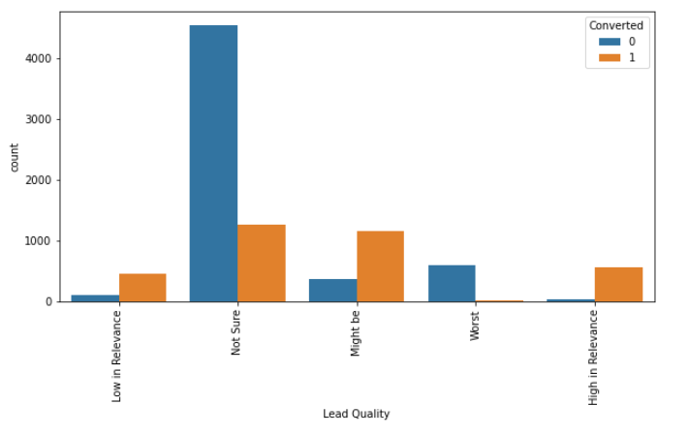
Target variable: Converted Independent variable: Lead Quality
We are analyzing the relationship between the target variable (Converted) and the independent variable (Lead Quality).
Some of the inferences we can draw are:
•People who are "Not sure" about the product are more likely to say no, but they still account for 20% of the conversions.
•People who are "Might be" interested in the product are more likely to say yes than no.
•People who have "High in relevance" leads are very likely to say yes, compared to those who say no.

Slide 6
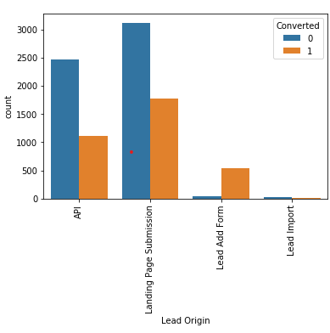
Lead Origin
Some of the inferences we can draw are:
The conversion rate of leads from the API and landing page submissions is around 30-35%, but the number of leads generated by these sources is significant.
The lead add form has a very high conversion rate of over 90%, but it also produces a large volume of leads.
The number of leads imported from other sources is very low.

Slide 7
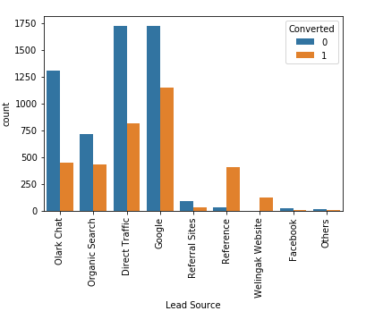
Lead Source
Some of the inferences we can draw are:
The main sources of leads are Google and direct traffic.
Reference leads and leads from welingak website have a high conversion rate.

Slide 8
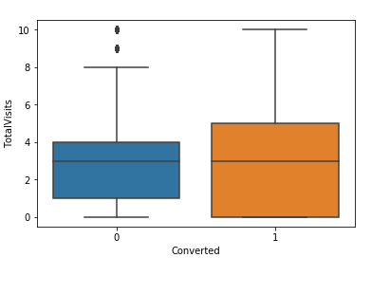
Total Visits
Some of the inferences we can draw are:
The conversion status of the leads does not affect the median value

Slide 9
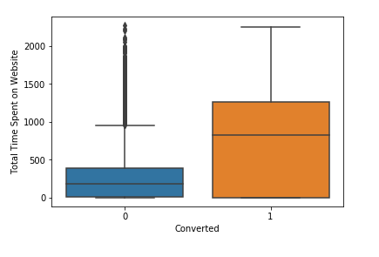
Target variable: Converted Independent variable: Total Time spend on Website
Some of the inferences we can draw are: The longer the leads stay on the website, the higher the chances of converting them.
Therefore, we should enhance the website's appeal and interactivity to keep the leads engaged.

Slide 10
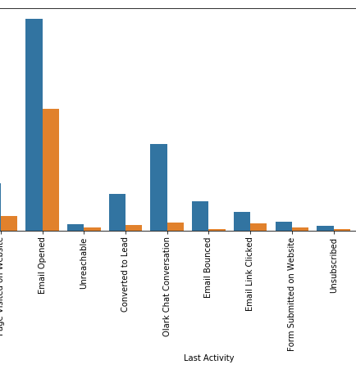
Last Activity
Some of the inferences we can draw are:
The last activity for most of the leads was opening their email.
Leads who received an SMS as their last activity had a conversion rate of almost 60%.

Slide 11
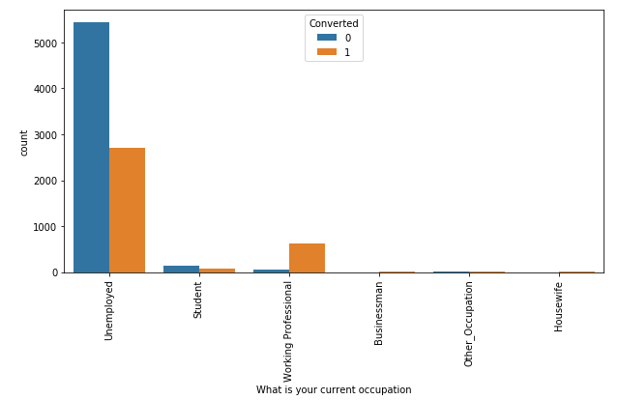
Whats your current occupation
The course is likely to attract working professionals who enroll in it.
Leads who are unemployed are the majority, but they have a conversion rate of around 30-35%.

Slide 12
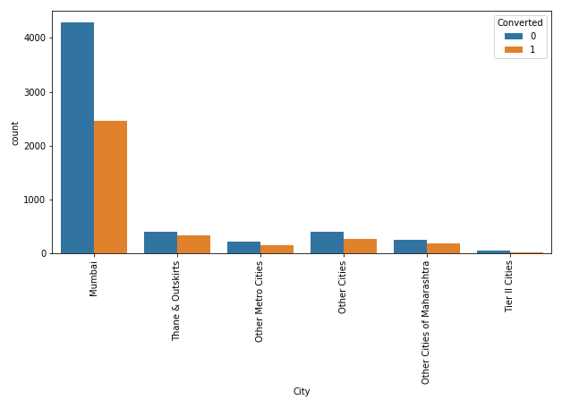
City Most leads are from Mumbai with around 30% conversion rate.

Slide 13

Machine Learning Logistic Regression

Slide 14
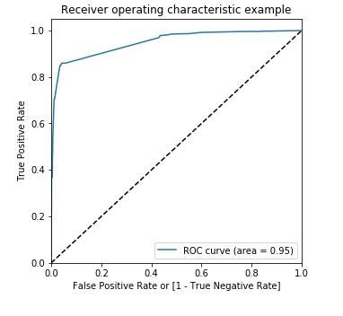
ROC Curve Inference: The ROC curve of our model is very close to the ideal line.
This indicates that our model has a high accuracy in predicting the outcomes.

Slide 15
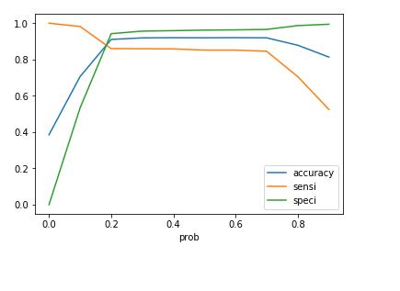
Optimal CUT- OFF We need to create a plot that shows the accuracy, sensitivity, and specificity for different probabilities.
Conclusion:
The graph indicates that the best cut off point is 0.2.

Slide 16
Similarity in the results of Train and Test data set
Accuracy 0.90
Specificity 0.94
Sensitivity 0.85

Slide 17
Top Variables from the Data:
Do not Email
Lead origin_lead add form
Lead source_welingak website
Whats your current occupation_unemployed
Tags_Busy
Tags_Closed by horizon
Tags_lost to EINS
Tags_ringing
Tags_will revert after reading the email
Tags_switched off
Lead Quality_Not sure
Lead Quality_Worst
Last Notable Activity _sms sent

Slide 18

Thank You

